Slide 1
CIT 260 Mid-Term Presentation
Straight & Narrow Team
Fred Hicken- Taylor Williams – Edgar Romero

Slide 2
7 Steps of The Function Development Process
Step 1 – Define the Problem
Step 2 – Create Test Matrix
Step 3 – Outline Solution
Step 4 – Test Algorithm
Step 5 – Translate to Code
Step 6 – Run Tests
Step 7 – Deploy Code

Slide 3
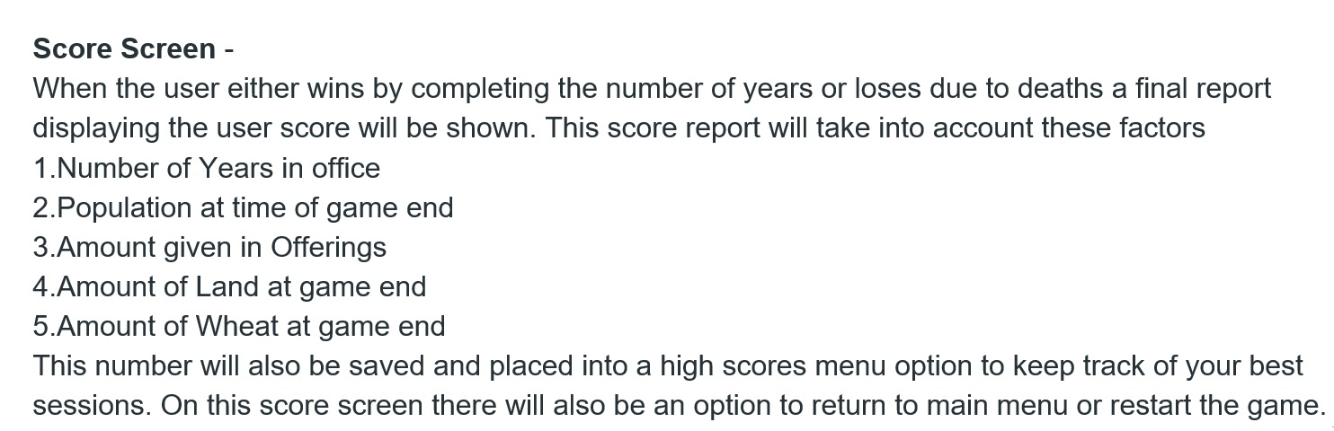
Step 1 Define The Problem

Slide 4
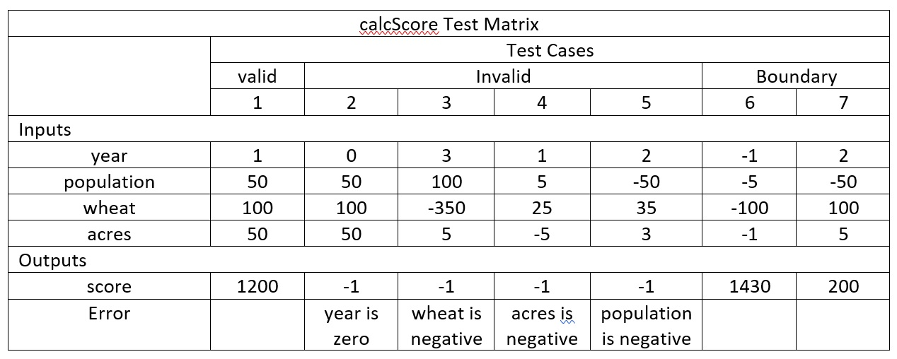
Step 2 Create A Test Matrix

Slide 5
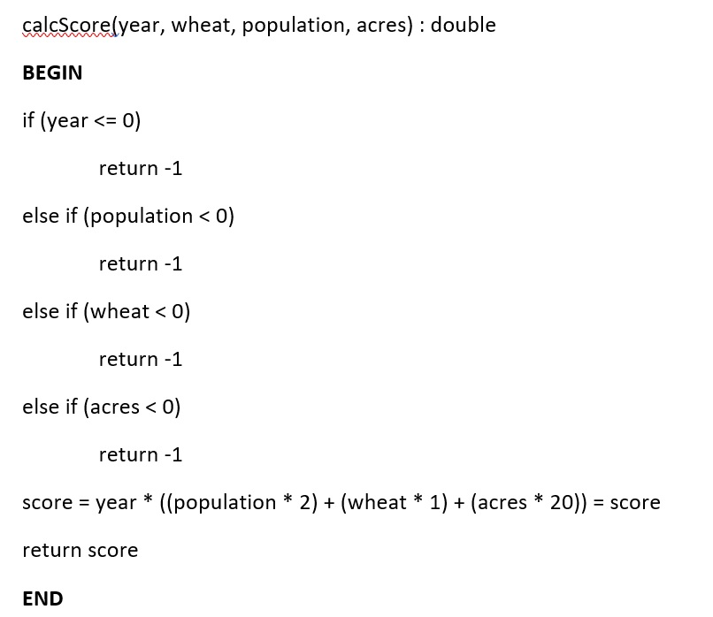
Step 3 Outline Solution

Slide 6
Step 4 Test Algorithm

Slide 7
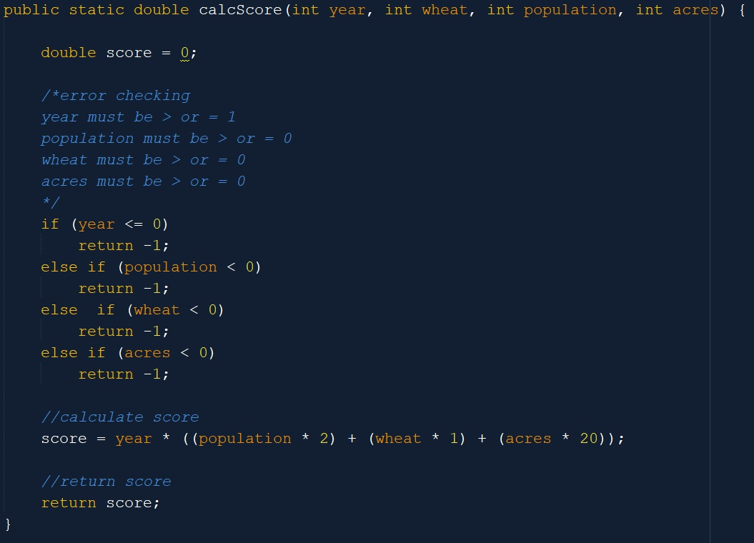
Step 5 Translate To Code

Slide 8
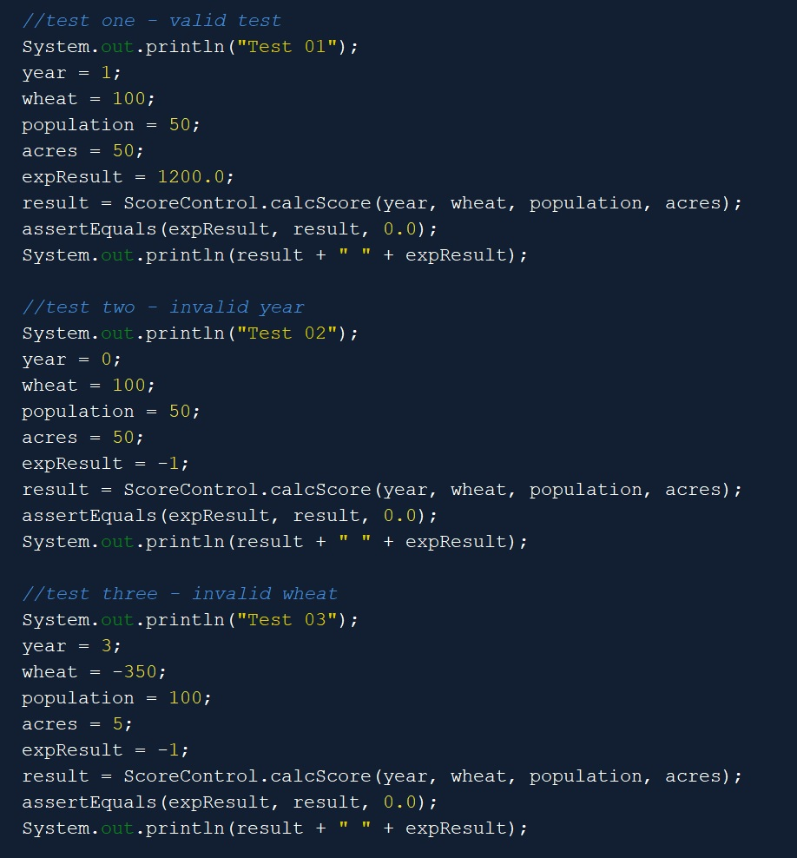
Step 6 & 7 Run Tests & Deploy
If Everything Passes Your Ready To Push Your Code To The Main Branch
(REMEMBER - Valid Test Cases Are Just As Important If Not More Than Invalid Test Cases)

Slide 9
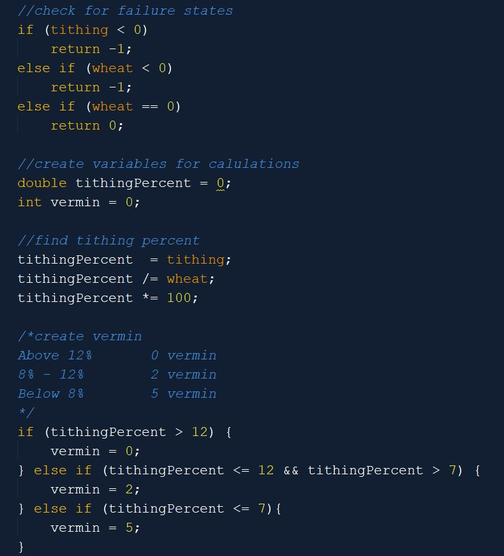
Fred Hicken Personal Code Selection
If Statements
Switch Statements

Slide 10
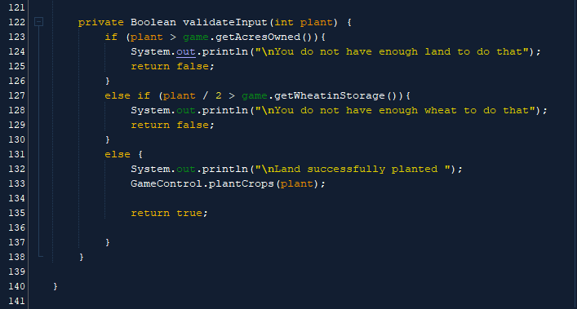
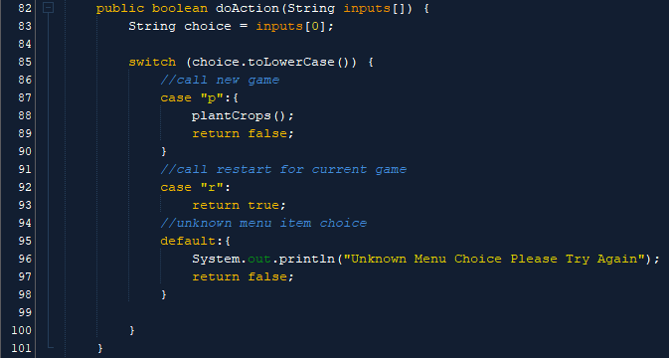
Taylor Williams Personal Code Selection
If Statements
Switch Statements

Slide 11
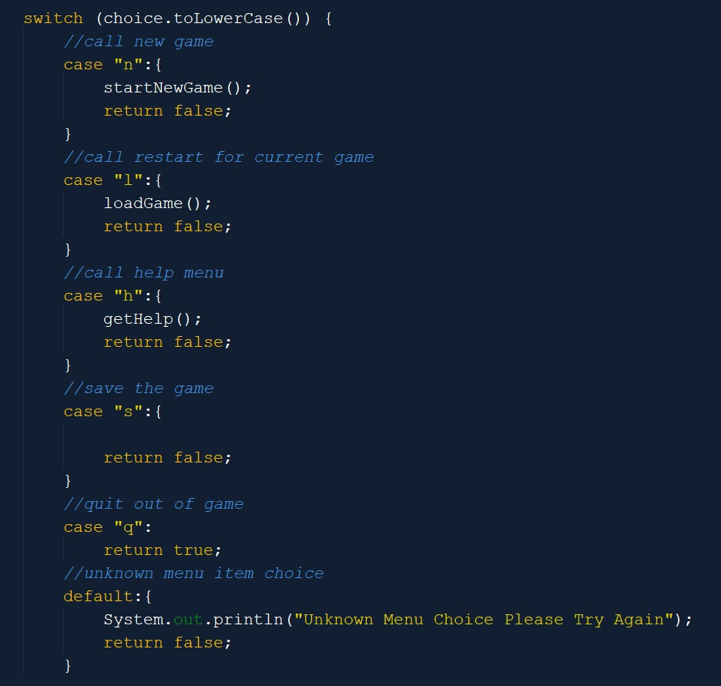
Edgar Romero Personal Code Selection
If Statements
Switch Statements

Slide 12
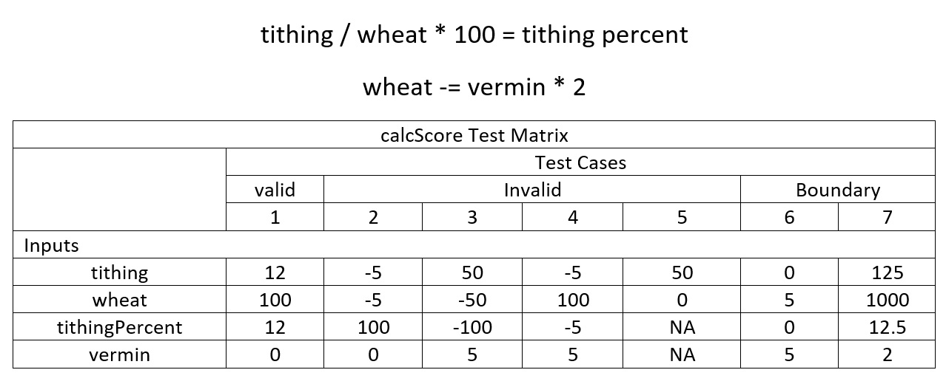
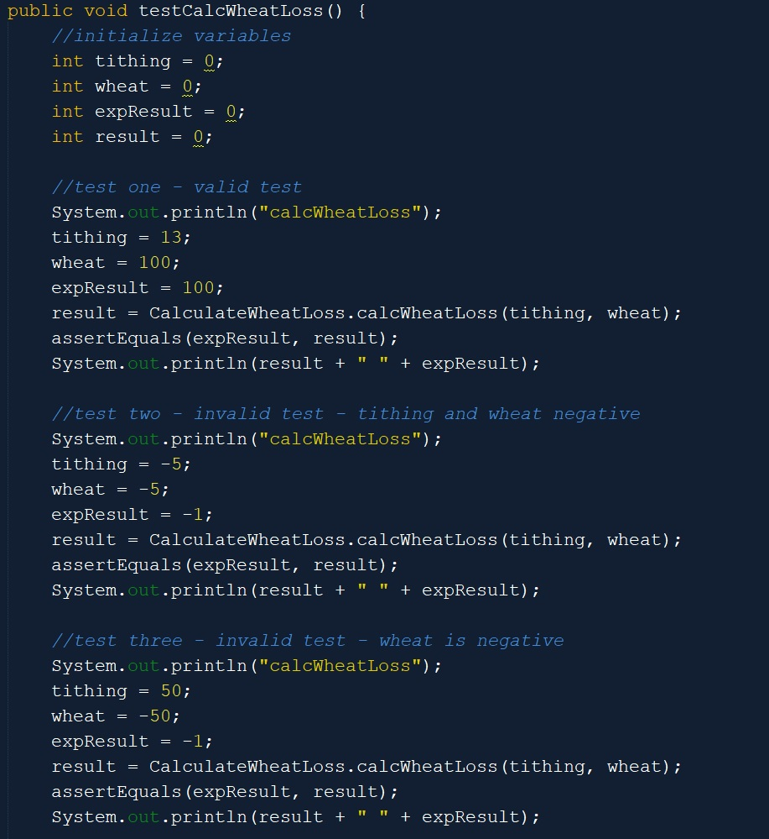
Fred Hicken Unit Test

Slide 13
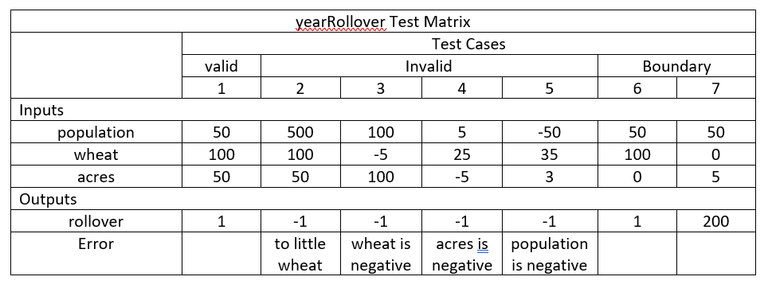
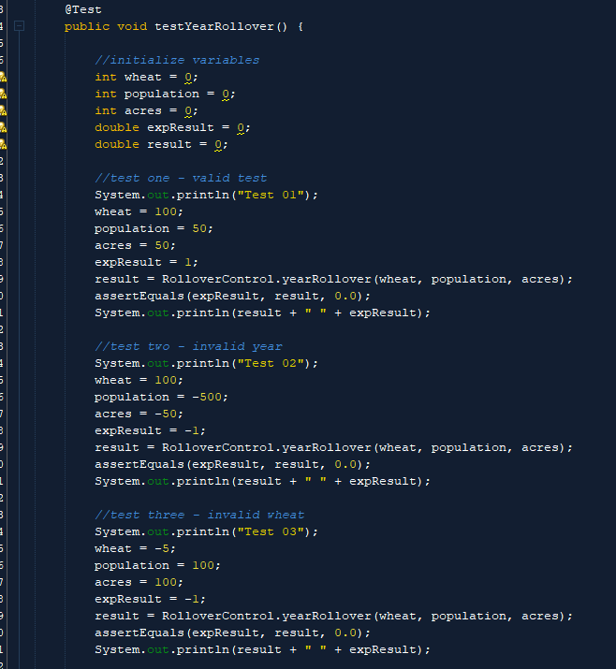
Taylor Williams Unit Test

Slide 14
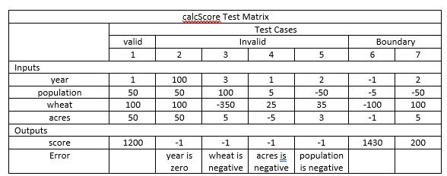
Edgar Romero Unit Test

Slide 15
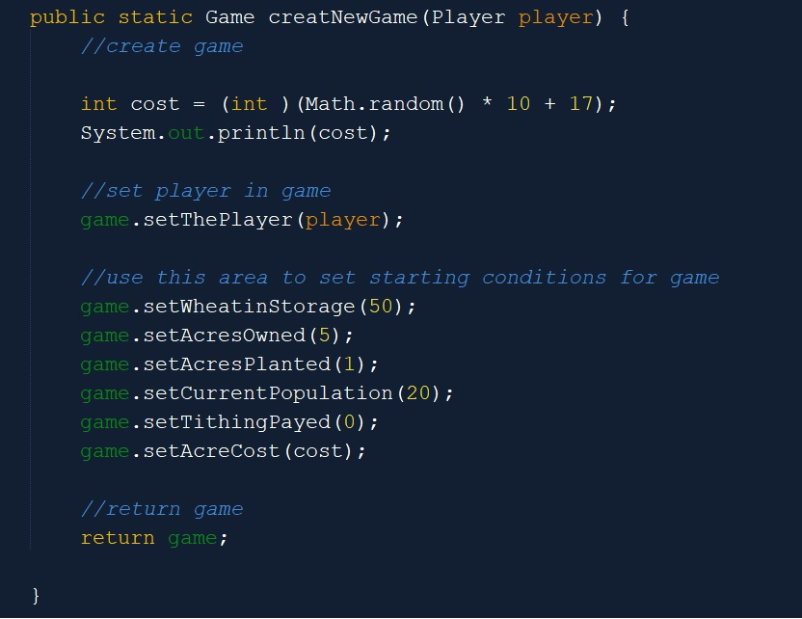
Team Showcase Scope & Lifespan of a Variable

Slide 16
Team Showcase Pass-By-Reference & Pass-By-Value

